Slide 1

AIR AMBULANCE
Department of Electronics and Communication Engineering
BATCH NO:07 PROJECT MEMBERS
M.Abdul aziz | 812419106002
S.Ayyanar | 812419106010
J.Jegan | 812419106021
R.Karthick pandiyan | 812419106023
PROJECT GUIDE | PROJECT CO-ORDINATOR
Dr. Ayshathul Fouzia Abdul Gani, M.E., Ph.D. | Dr.S.Archana,M.Tech.,Ph.D.

Slide 2
CONTENTS
OBJECTIVE
INTRODUCTION
LITERATURE SURVEY
PROPOSED WORK
METHODOLOGY
ANGLE OF WHEEL POSITION
BLOCK DIAGRAM
SOFTWARE SPECIFICATION –Arduino IDE
ARDUINO CODE
POSITION OF PROTOTYPE
WORKING PRINICPLE
APPLICATION
ADVANTAGE AND DISADVANTAGE
CONCLUSION

Slide 3
OBJECTIVES
The purpose of this work is to explore the use of air ambulance services as a means of providing rapid medical assistance to critically ill or injured patients in remote or inaccessible areas.
Here, we explore the advantages of using air ambulances, such as faster transport times, improved medical comfort and the ability to transport patients over long distances.
The idea proposed in this work uses drones and helium gas balloons to facilitate transport on land, water and air.

Slide 4
INTRODUCTION
The ever increasing traffic congestion on roads is creating a challenge for ambulance drivers in finding way to reach hospitals to save the lives of people in casuality.
The objective of the proposed work is to circumvent the heavy traffic zones by introduced manned air-ambulance.

Slide 5
LITERATURE SURVEY
Ref | Title | Parametr1 | Parameter2
[4]Altran En-Route to Urban Air Mobility on the Fast Track to Viable and Safe on-Demand Air Services.(Mar.2020) | EN-ROUTE TO URBAN AIR MOBILITY | Roadways: 30 km/hr Airways: 225 km/hr | Budget: MarketsandMarkets: $15 billion Morgan Stanley: $322 billion

Slide 6
PROPOSED WORK
We proposed that our work is based on the idea of flying vehicle using of Drone mechanism to lifted up while stuck in the traffic on the roadways.
Also, there may be a Floating mechanism by using air balloons of an object floats when the weight force on the object is balanced by the upward push of the water on the object.
These above two mechanisms are to be implemented in our project work to get completed successfully.

Slide 7
METHODOLOGY
when the road is jammed, the rod installed in this vehicle in all four directions will lift the vehicle, and when it is lifted, the direction of the four wheels will change.
Helium gas installed on all sides of the vehicle reduces the weight of the vehicle.
A helium gas balloon attached to the bottom of the vehicle makes the vehicle buoyant when the vehicle is submerged for a certain distance.
When the front wheel of the vehicle rises up to 20 degrees and the rear wheel rises up to 30 degrees, it reaches the destination easily with the help of a boat mounted on the wheel of the vehicle.

Slide 8
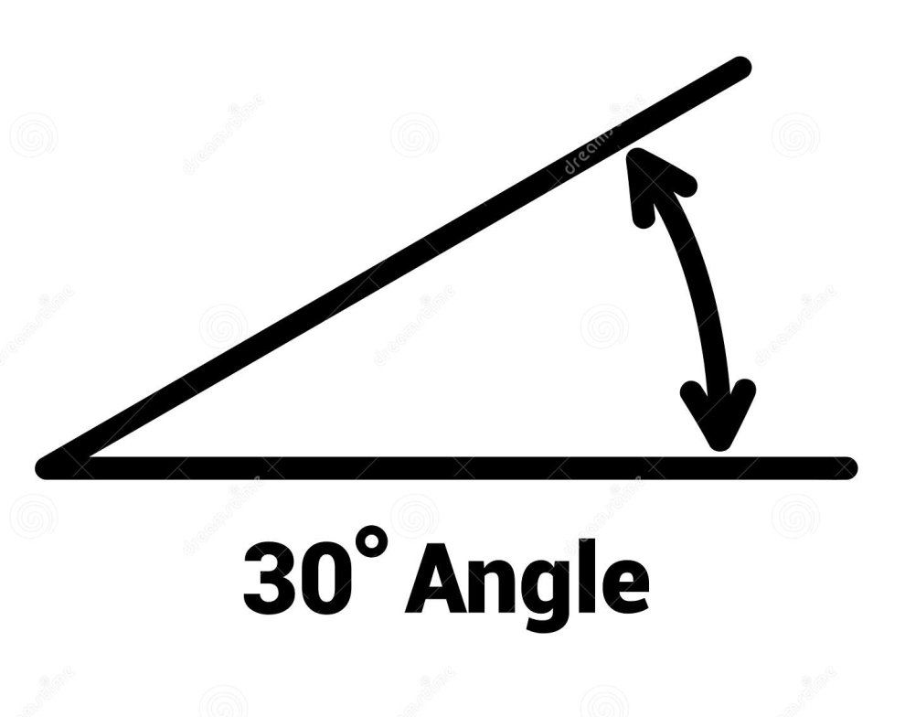
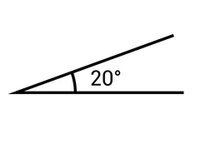
Angle of Wheel Position
Rear wheel Position Front wheel Position

Slide 9
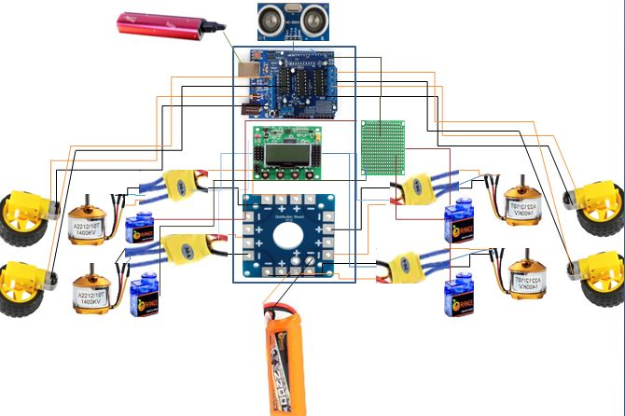
BLOCK DIAGRAM

Slide 10
SOFTWARE SPECIFICATION –Arduino IDE
Arduino is an open-source electronics platform based on easy-to-use hardware and software.
Arduino boards are able to read inputs- light on a sensor, a finger on a button, or a Twitter message – and turn it into an output – activating a motor, turning on an LED, publishing something online.
The features of Arduino UNO are
Inexpensive
Cross-platform
Simple, clear programming environment
Open source and extensible software

Slide 11
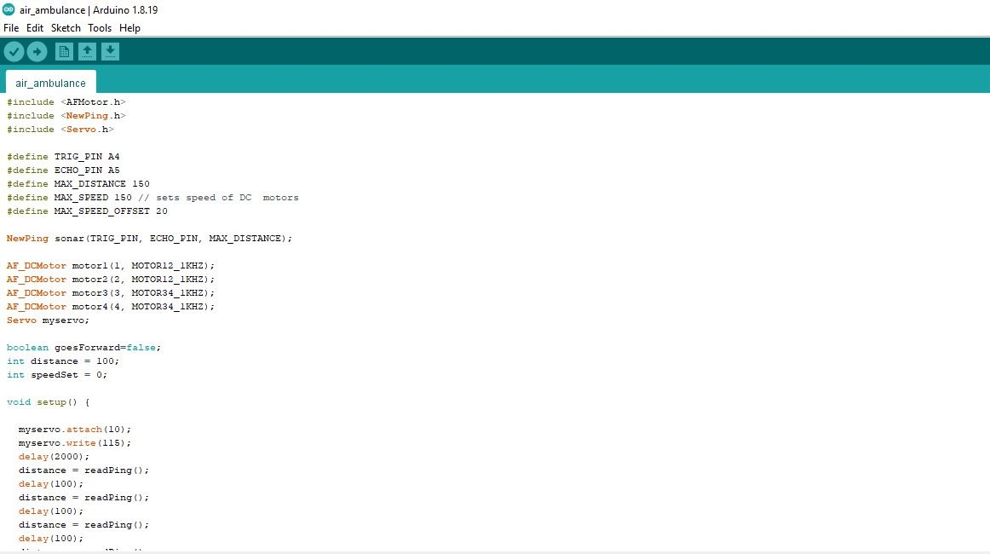
Arduino Code

Slide 12
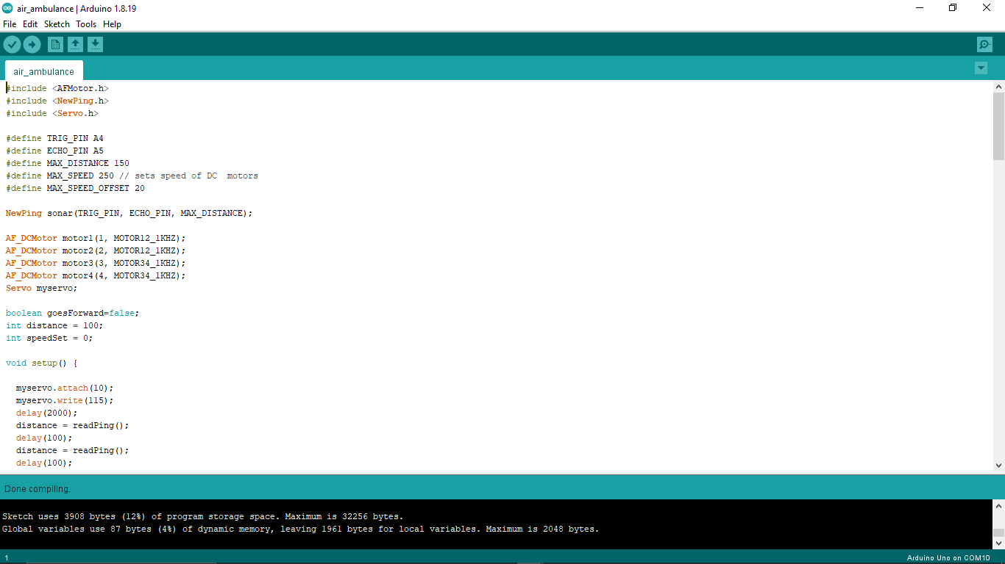

Slide 13
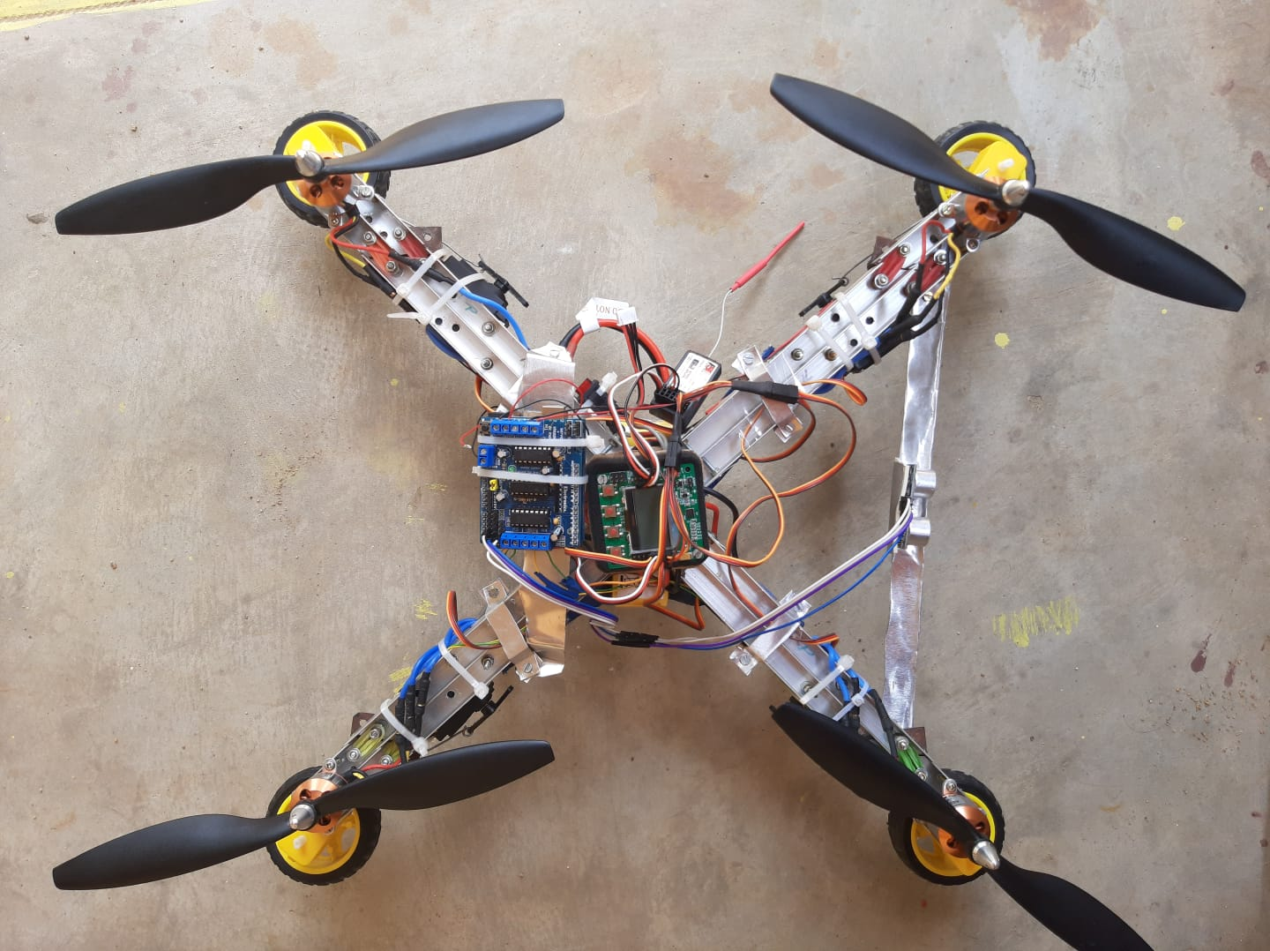
FLYING POSITIION OF PROTOTYPE

Slide 14
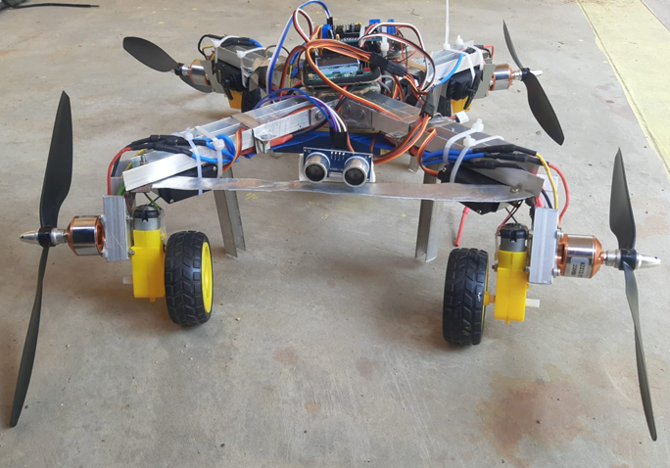
RUNNING POSITIION OF PROTOTYPE

Slide 15
APPLICATION
Hospital purpose only.

Slide 16
ADVANTAGE
This vehicle is unlike any other vehicle capable of moving on water and air.
This can save many lives quickly.

Slide 17
DISADVANTAGE
This vehicle cannot fly very high.
Can not lift over weight.

Slide 18
CONCLUSION
This project can save people's lives quickly.
The drone can move in any direction with the help of helium gas.
The main objective of the vehicle is to reach the hospital faster than the existing ambulance.

Slide 19
REFERENCES
[1] PAN, G., & ALOUINI, M.-S. (2021). FLYING CAR TRANSPORTATION SYSTEM: ADVANCES, TECHNIQUES, AND CHALLENGES. IEEE ACCESS, 9, 24586– 24603
[2] Bogdan Radu, Shelton, CT(2013), FLYING VEHICLE, US 8,827,200 B2
[3]Md Mohaimenuzzaman,1 S. M. Monzurur Rahman,1 Musaed Alhussein,2 Ghulam Muhammad,2 and Khondaker Abdullah Al Mamun1. (2016). ENHANCING SAFETY IN WATER TRANSPORT SYSTEM BASED ON INTERNET OF THINGS FOR DEVELOPING COUNTRIES.2834616
[4] Brandon R. Sutherland(2019).FLYING CARS FOR GREEN TRANSPORTATION, Joule 3, 1180–1189, May 15, 2019 ª 2019
[5] Mernout Burger, Bart De Schutter(2013).ENERGY-EFFICIENT TRANSPORTATION OVER FLOWING WATER, 978-1-4673-5200-0/13/$31.00 ©2013 IEEE

Slide 20
Kaushik Rajashekara, Qingchun Wang, and Kouki Matsuse(2016). FLYING CARS: CHALLENGES AND PROPULSION STRATEGIES, 2325-5987/16©2016IEEE
Adekunle Mofolasayo(2019),POTENTIAL POLICY ISSUES WITH FLYING CAR TECHNOLOGY, 2352-1465 © 2020, 10.1016/j.trpro.2020.08.002
Harsh A. Nakum(2020), AIR CAR: A REVIEW ON THE INVENTION OF FLYING AUTOMOBILE, ISSN: 2278-0181
Nasir Saeed, Tareq Y. Al-Naffouri, and Mohamed-Slim Alouini(2021) WIRELESS COMMUNICATION FOR FLYING CARS, DOI: https://doi.org/10.21203/rs.3.rs-155561/v1
Miss Reni Varghese , Miss. Ayushi Nair , Mr. Libin George Alexander Mr. Sajilal R Nair, Mr. Mohamed Moniskhaleel (2015), COMPARISON OF FLYING CARS SINCE 2000 AND FACTORS CONSIDERED FOR ITS CONCEPTUAL DESIGN, ISSN: 2278-0181 Published by, www.ijert.org NCERAME - 2015 Conference Proceedings

Slide 21
THANK YOU…

